Slide 1
Prospects for the global economy and for Croatia
Lider Conference, Zagreb, 27 September, 2023
Phil Hemmings, Head of Country Studies V,
Economics Department, OECD, Paris.

Slide 2
19 September 2023
Download data

Slide 3
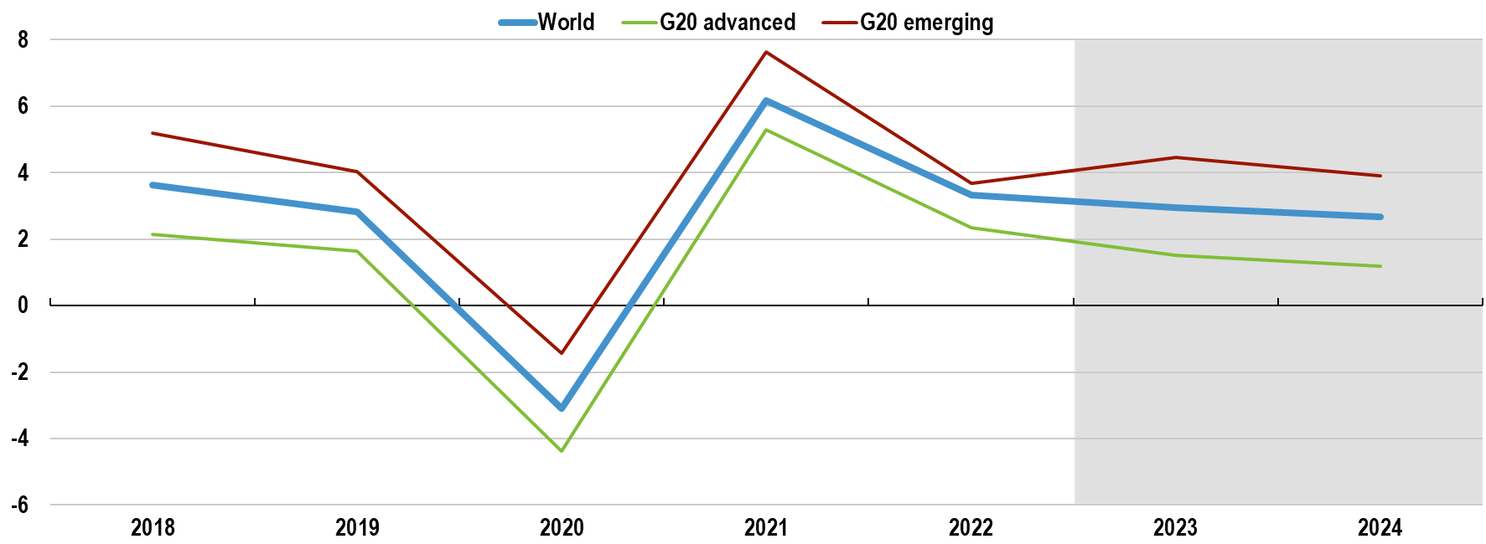
World GDP growth is expected to remain weak but positive
Real GDP growth
  %, y-o-y
Note: Shaded area indicates projection period. G20 advanced countries are Australia, Canada, France, Germany, Italy, Japan, Korea, the United Kingdom and the United States. G20 emerging countries are Argentina, Brazil, China, India, Indonesia, Mexico, Russia, Saudi Arabia, South Africa and Türkiye.
Source: OECD Interim Economic Outlook 114 database.

Slide 4
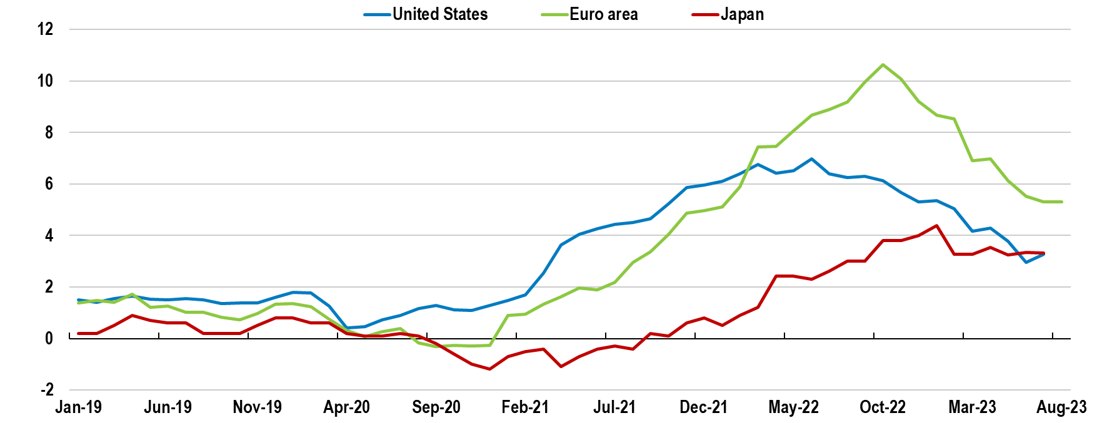
Headline inflation is coming down but remains high
Headline inflation
  %, y-o-y
Note: The chart refers to the personal consumption expenditures price index (PCE) for the United States, harmonised CPI for the euro area and consumer price index (CPI) for Japan. For the euro area, the August number is a flash estimate.
Source: OECD Consumer Price database; Eurostat; and OECD calculations.

Slide 5
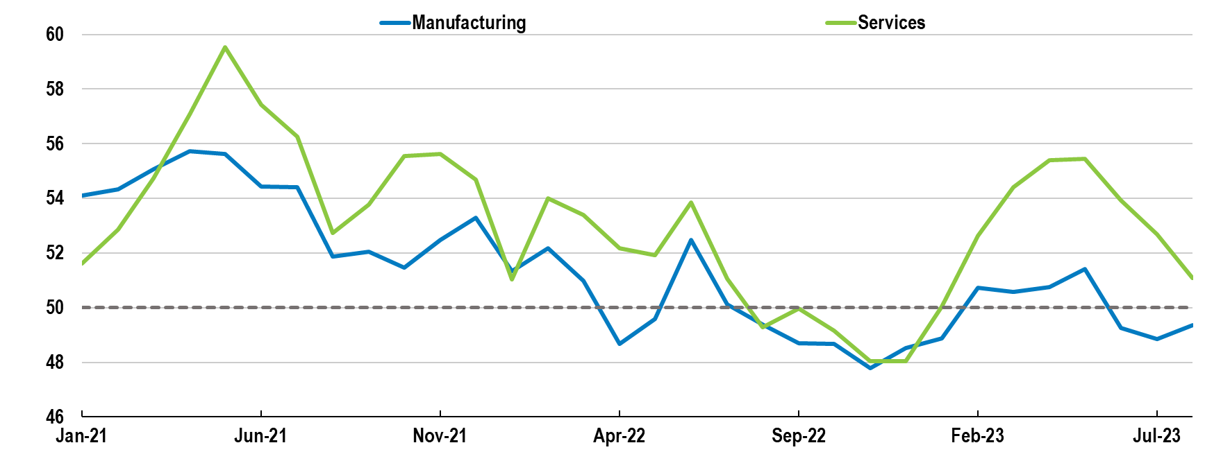
Growth is expected to slow in the near term
Global PMI
  Values below 50 point to contracting activity
Note: Chart shows Purchasing Managers’ Index (PMI), a survey-based economic indicator providing timely insight into business conditions.
Source: S&P Global.

Slide 6
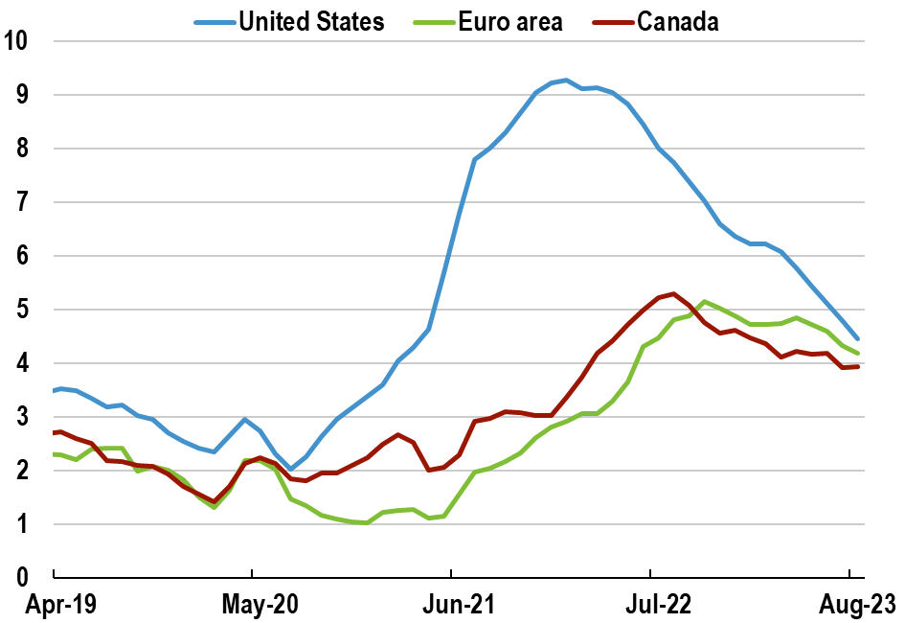
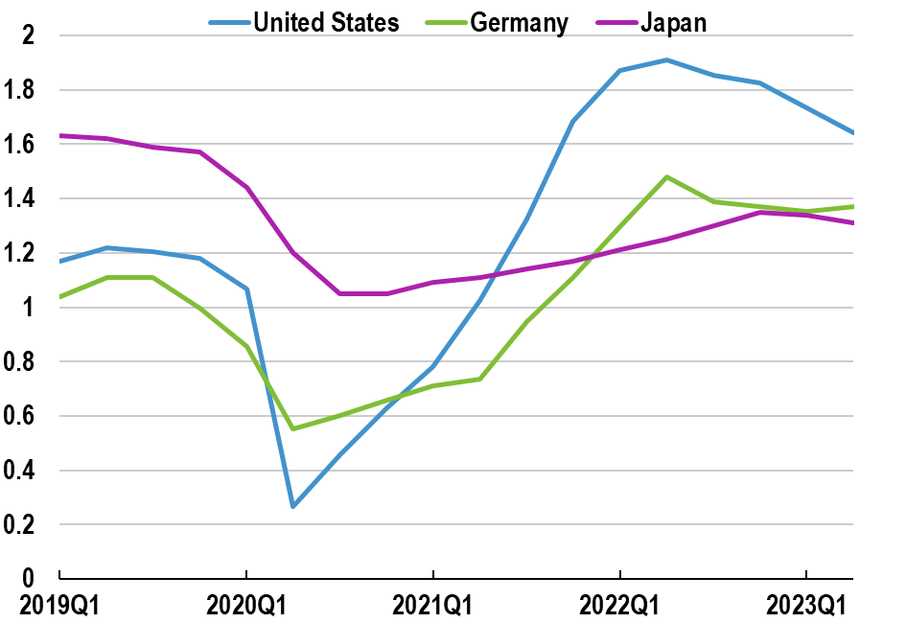
Labour markets remain tight but pressures are easing
Wage growth
  %, y-o-y, advertised wages
Job vacancies per unemployed
Note: Chart shows 3-month moving average of the y-o-y posted nominal wage growth.
Source: Indeed Wage Tracker (Indeed Hiring Lab).
Note: Job vacancies per unemployed for the United States and Germany is the number of unfilled vacancies (s.a.) over the number of unemployed population (s.a.). The unemployed population is the unemployed aged 15 and over for the United States and the 3 month average of the unemployed population aged 15-74 for Germany. For Japan, job vacancies per unemployed is the ratio of active job openings to active applicants (s.a.).
Source: OECD Short Term Labour Situation database; Eurostat; Ministry of Health, Labour and Welfare, Japan; and OECD calculations.

Slide 7
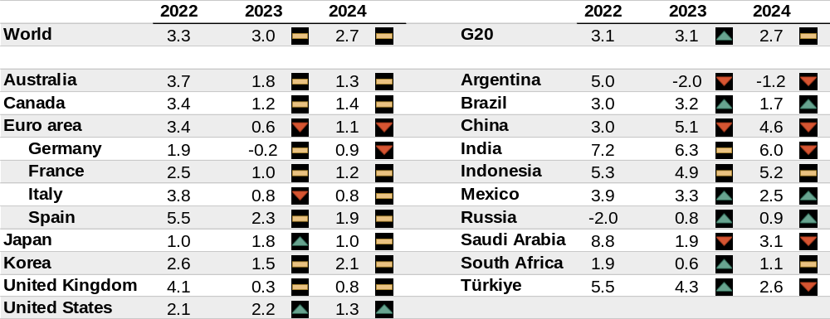
GDP growth projections
  Real GDP, y-o-y growth, %
Note: Revisions relative to the latest estimates from the June 2023 Economic Outlook. India projections are based on fiscal years, starting in April. The European Union is a full member of the G20, but the G20 aggregate only includes countries that are also members in their own right. Spain is a permanent invitee to the G20. World and G20 aggregates use moving nominal GDP weights at purchasing power parities.
Source: OECD Economic Outlook 113 databases; and OECD Interim Economic Outlook 114 database.

Slide 8
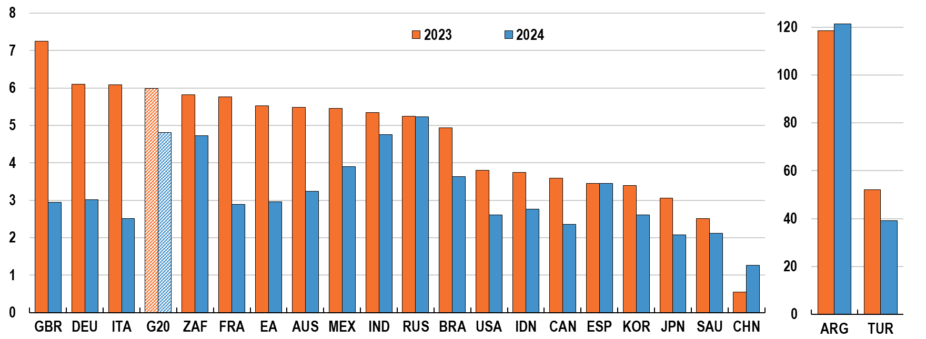
Inflation projections
  G20, headline inflation, %
Note: Figure shows personal consumption expenditure price index for the United States, harmonised index of consumer prices for the euro area and its member states and the United Kingdom, and national consumer price index for all other countries. India projections are based on fiscal years, starting in April.
Source: OECD Interim Economic Outlook 114 database.
Notes:
(5th ver IEO) 2023 2024
G20 adv 4.5% 2.6%
G20 eme 7.2% 6.6%
G20 excl. ARG and TUR 3.6% 2.7%

Slide 9
Risks

Slide 10
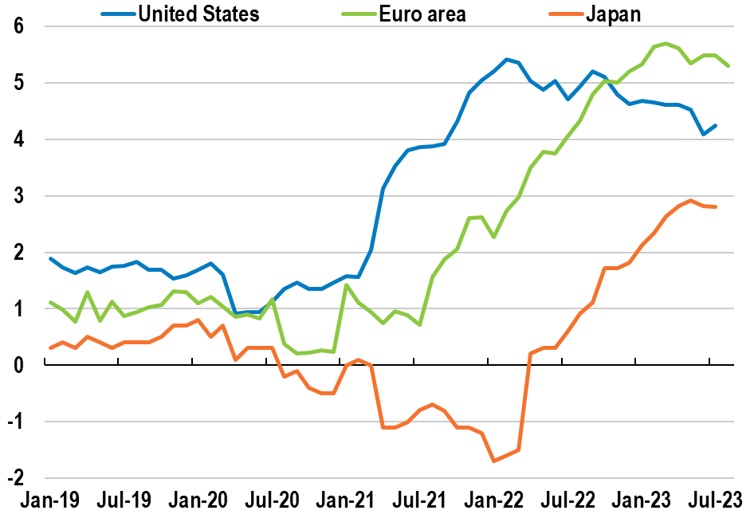
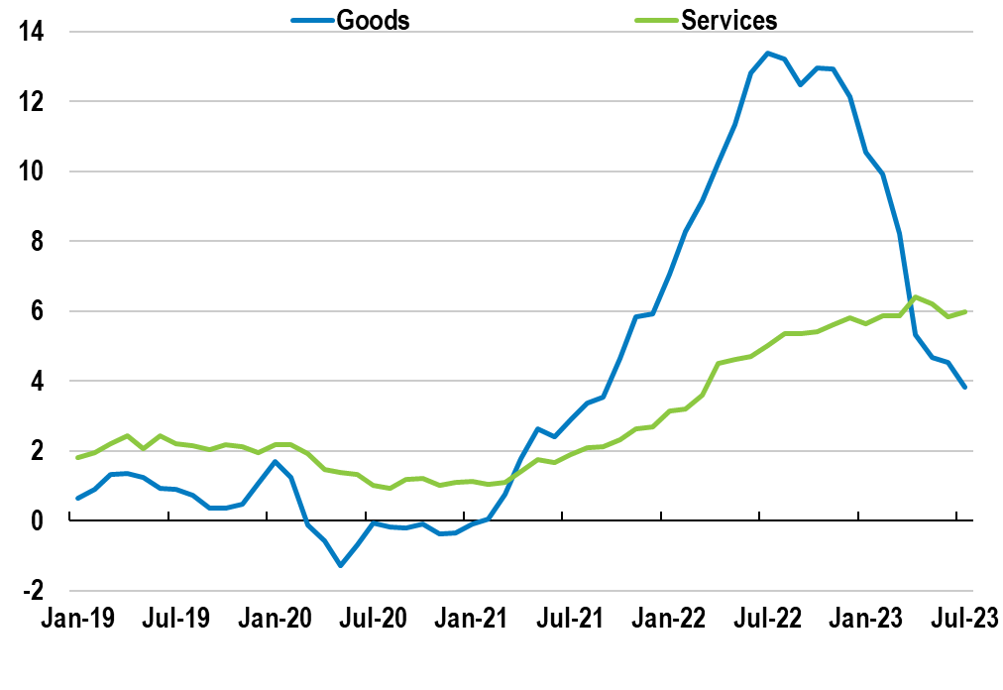
Inflation persistence is a source of concern
Core inflation
  %, y-o-y
Sectoral consumer price inflation
  %, y-o-y, median advanced economies
Note: For the euro area, the August number is a flash estimate.
Source: OECD Consumer Price database; Eurostat; and OECD calculations.
Note: Headline inflation. Country samples are based on data availability. Countries included for goods inflation are Austria, Canada, Czech Republic, Denmark, France, Greece, Hungary, Ireland, Israel, Italy, Japan, Korea, Latvia, Lithuania, Luxembourg, Netherlands, Poland, Portugal, Slovakia, Slovenia, Spain, Switzerland, the United Kingdom and the United States. For services inflation, Belgium and Estonia are also included.
Source: OECD Consumer Price database; and OECD calculations.

Slide 11
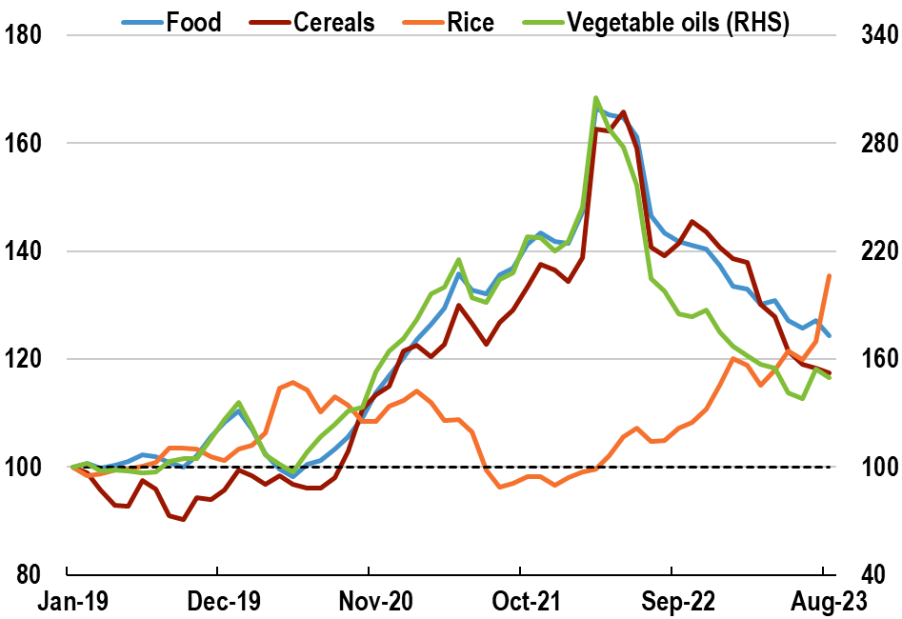
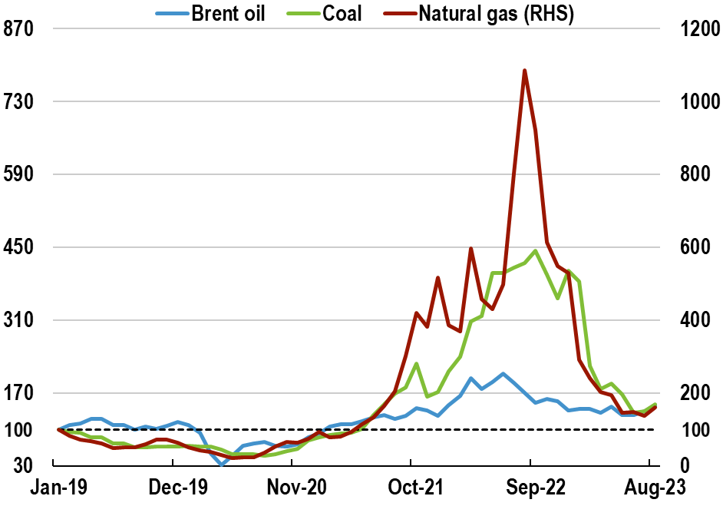
Disruptions to food and energy markets are still a risk
FAO food price index
  Index, January 2019 = 100
Wholesale energy prices
  Index, January 2019 = 100
Note: Price indices in real terms.
Source: FAO; and OECD calculations.
Note: Coal refers to the HWWI coal price and natural gas corresponds to the Dutch Transfer Title Facility (TTF). Figures are based on the monthly average up to August 2023. Dotted line shows the index in January 2019 = 100.
Source: Refinitiv; and OECD calculations.

Slide 12
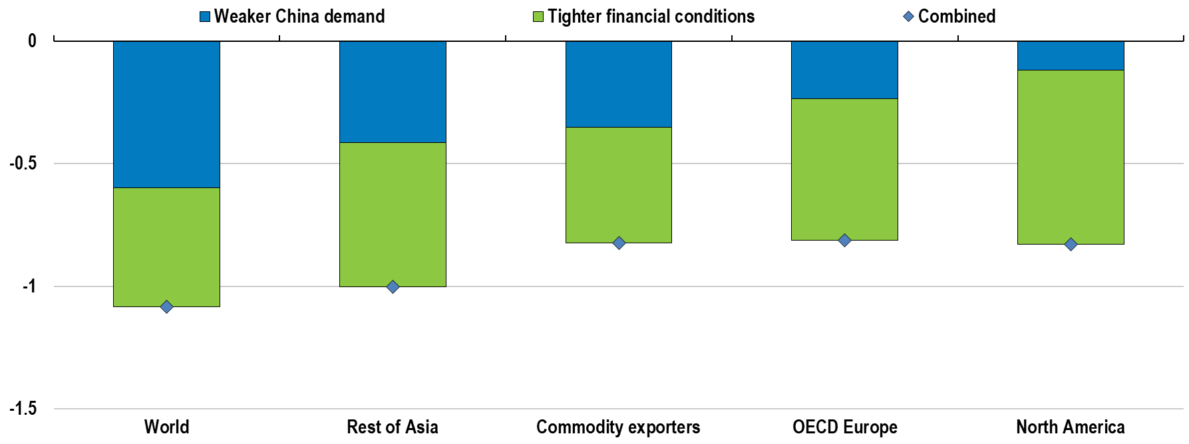
A further weakening of China would hurt the global economy
Simulated GDP impact in first year
  % difference from baseline
Note: Simulated impact of an unanticipated one year slowdown of 3% in China domestic demand growth, an increase of 50 basis points in global investment risk premia and an average decline of 10% in equity prices in all countries, and an endogenous monetary policy reaction. The blue bar shows the direct impact of the slowdown in domestic demand; the green bar shows the additional impact from higher uncertainty and lower equity prices. Commodity exporters include Argentina, Brazil, Chile, Indonesia, Norway, Russia, South Africa and other non-OECD oil-producing countries. Rest of Asia includes India, Japan, Korea and the Dynamic Asian Economies (excluding Indonesia).
Source: OECD calculations using NiGEM.

Slide 13
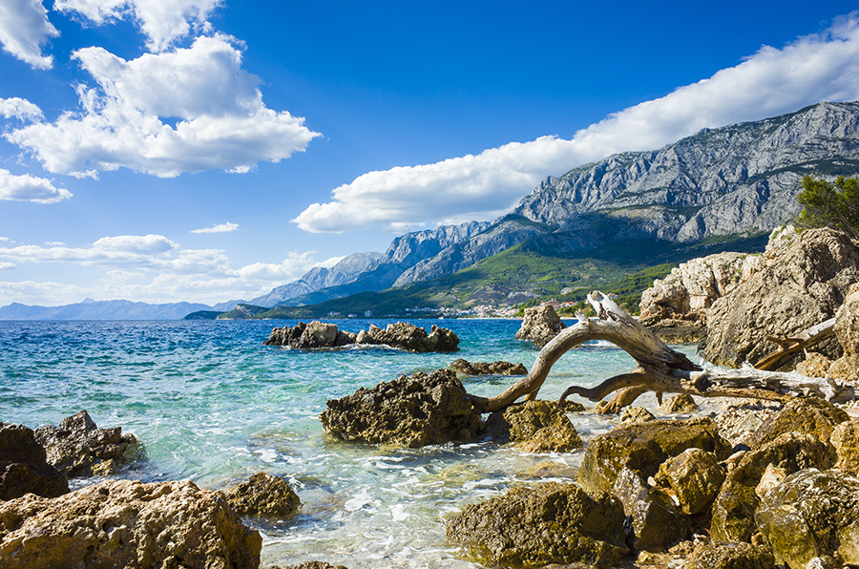


OECD ECONOMIC SURVEY
OF CROATIA
For faster and sustainable convergence
Zagreb, 21 September 2023
@OECD
@OECDeconomy
oe.cd/Croatia

Slide 14
Growth is resilient
GDP growth, annual
Note: The shaded area shows projections. Peers are an average of the Czech Republic, Hungary, the Slovak Republic and Slovenia.
Source: OECD Economic Outlook 113 (database), updated.

Slide 15
The labour market is tight
Labour market indicators
Note: 2023Q1 and 2023Q2 observations are OECD preliminary estimates, based on published labour force data adjusting for a series break between 2022Q4 and 2023Q1.
Source: OECD Economic Outlook (database).

Slide 16
Inflation is slowly declining
Note: Core, headline and energy inflation are based on the harmonised consumer price index. Core inflation excludes energy and food products.
Source: OECD Economic Outlook (database) and Eurostat.

Slide 17
Fiscal policy should avoid a widening deficit in 2023 and 2024
Fiscal balance and fiscal balance corrected for the business cycle
Note: The fiscal balance corrected for the business cycle measures the governments fiscal stance once cyclical variation in revenues and spending are taken into account and excludes net one-off operations.
Source: OECD Economic Outlook 113 (database), updated.

Slide 18
Robust growth needs to continue for incomes to converge
Real GDP per capita relative to the OECD average
Note: Real GDP per capita at 2015 prices and PPPs.
Source: OECD National Accounts database.

Slide 19

Achieving faster convergence by boosting productivity and investment

Slide 20
Better monitoring regulatory burdens would unlock the benefits ongoing reforms
Product market regulation index
Index, 0-6, 0 indicates most competition-friendly regulations
Notes: OECD Product Market Regulation Index, preliminary 2018 and 2023 values applying the 2023 methodology.
Source: OECD 2023 PMR database (July 2023).

Slide 21
Encouraging out-of-court processes would make the judicial system more responsive
Note: Unweighted average for EU and Peers, which includes the Czech Republic, Hungary, the Slovak Republic and Slovenia.
Source: European Commission (2023), The 2023 EU Justice Scoreboard.

Slide 22
Stronger governance of state-owned enterprises is key given their share in the economy
SOEs’ share of total non-agricultural dependent employment, 2019
Source: OECD (2021), OECD Capital Market Review of Croatia: Capital market reforms for recovery and improved business dynamics in Croatia.

Slide 23
Encouraging ethnical behaviour among public officials would complement anti-corruption measures
Corruption by sector, "Control of Corruption"
Scale: 0 (worst) to 1 (best), 2021
Note: Unweighted average for OECD.
Source: Varieties of Democracy Project, V-Dem Dataset v12.

Slide 24

Raising skills and participation to lift incomes and support inclusiveness

Slide 25
A big push on training and activation would help solve shortages of skilled workers
Share of firms reporting lack of right skilled staff as an obstacle to investment, 2021
Source: EIB (2022), Investment Survey.

Slide 26
Pension reform should encourage Croatians to retire later
Average number of worked years, 2019
Note: An unweighted average across men and women is shown.
Source: European Commission (2021), Ageing report 2021

Slide 27
Attracting skilled immigrants and encouraging return migration would increase labour supply
Migration flows
Source: United Nations, World Population Prospects 2022, and Eurostat.

Slide 28

Ensuring robust growth is also sustainable

Slide 29
Further investing in public transport and restricting polluting cars would reduce air pollution
% of population exposed to particle air pollution
Note: Air pollution measured in PM2.5 particles.
Source: OECD Environmental Statistics (database).

Slide 30
Pricing greenhouse gas emissions consistently and investing in energy efficiency would help reduce emissions
Greenhouse gas emissions
Note: GHG emissions include land use, land-use change and forestry (LULUCF).
Source: OECD (2022), Environment Statistics (database).

Slide 31


For more information
OECD Economics
OECD
oe.cd/Croatia
Disclaimers:
The statistical data for Israel are supplied by and under the responsibility of the relevant Israeli authorities. The use of such data by the OECD is without prejudice to the status of the Golan Heights, East Jerusalem and Israeli settlements in the West Bank under the terms of international law.
This document and any map included herein are without prejudice to the status of or sovereignty over any territory, to the delimitation of international frontiers and boundaries and to the name of any territory, city or area.

